Slide 1
Data Analysis: Sales Prospects from Home Mortgage Data

Slide 2
Qualification Criteria
Criteria to identify target borrowers
● Have loan-to-value ratios below 80 (so they have significant equity in their homes)
● Have homes in locations with a high minority population (which would enable JPMorgan Chase & Co. to increase support to those communities, which is both a regulatory and a strategic requirement)
● Have annual incomes over a certain threshold (so they are more likely to be able to afford more financial products and services)
● Have homes worth an amount over a certain threshold (so they are more likely to want to invest in them further or borrow against them)

Slide 3
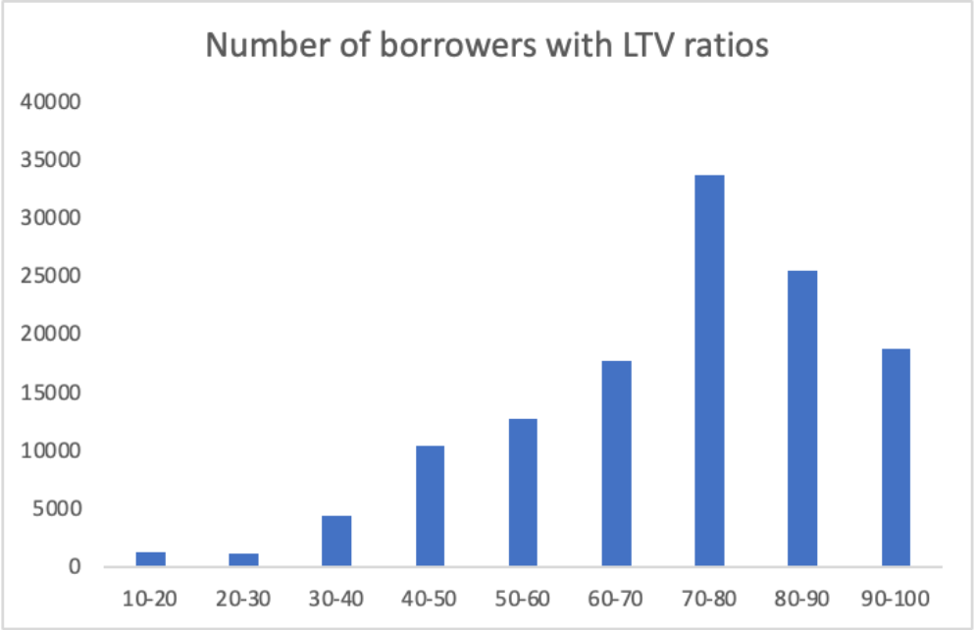
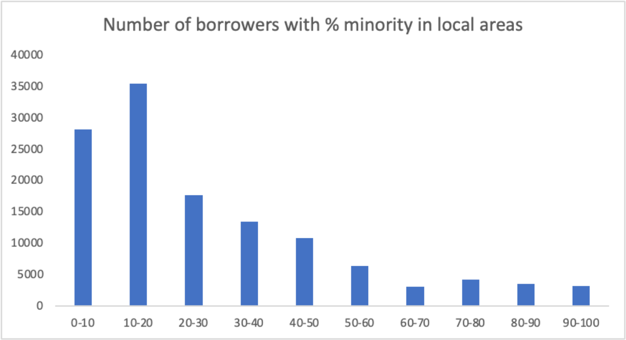
Observations
The percentage of borrowers with LTV ratios below 80 is 65%.
The percentage of borrowers, who have homes in locations with over 60% minority population, is 11%.

Slide 4
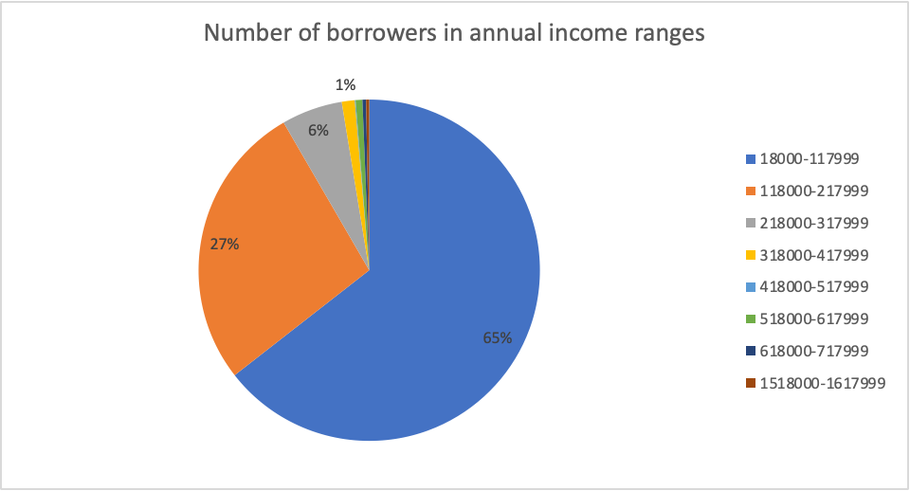
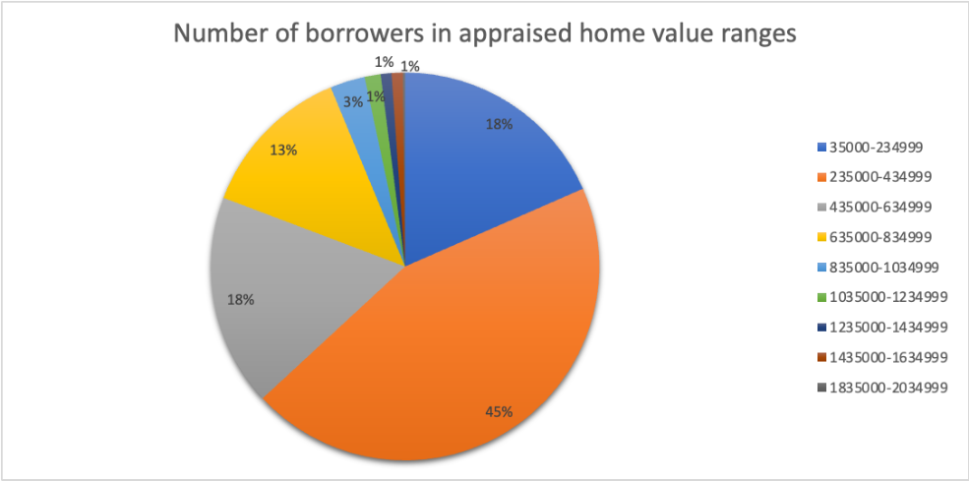
Observations
92% borrowers' annual income are below 218,000. Set the threshold as 218,000, which means people, who have annual income equal or more than this amount, are more likely to want to invest in financial products and services further or borrow against them.
63% borrowers' appraised home values are below 435000. Set the threshold as 435,000, which means people, who have homes worth than or over this amount, are more likely to want to invest in financial products and services further or borrow against them.

Slide 5
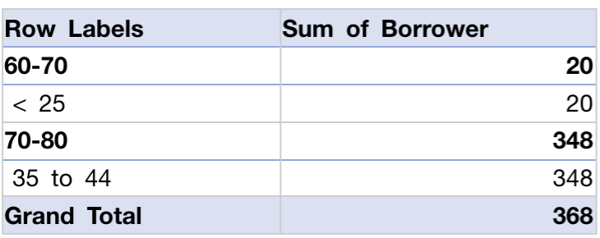
Key Insights
Overall, there are 368 borrowers should be targeted. These targets all have annual income above $218,000, appraised home value above $435,000, and LTV ratio below 80%.
Among them 95% aged 35 to 44 and have homes in locations with 70%-80% minority population.
The other 5% aged below 25 and have homes in locations with 60%-70% minority population.

